Slide 1


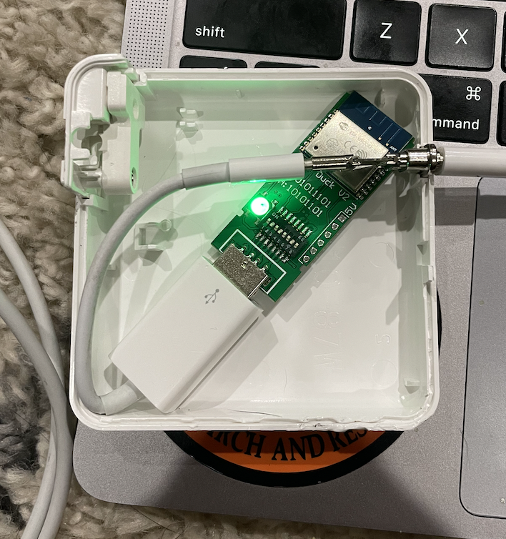
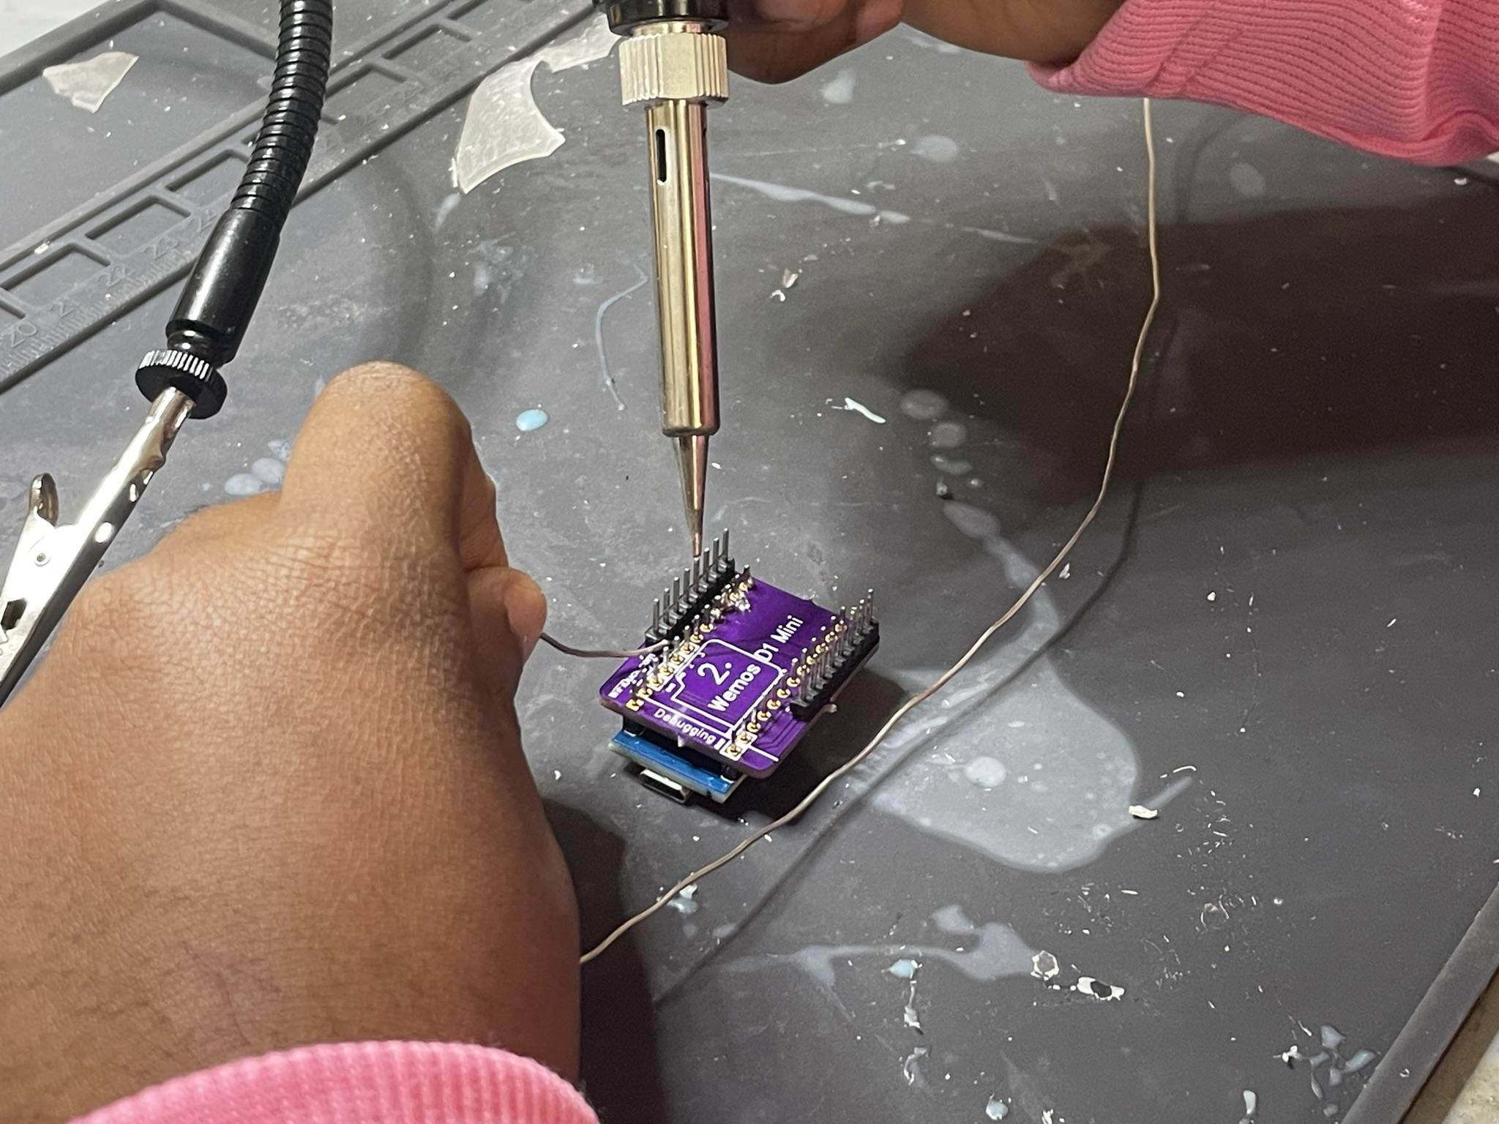
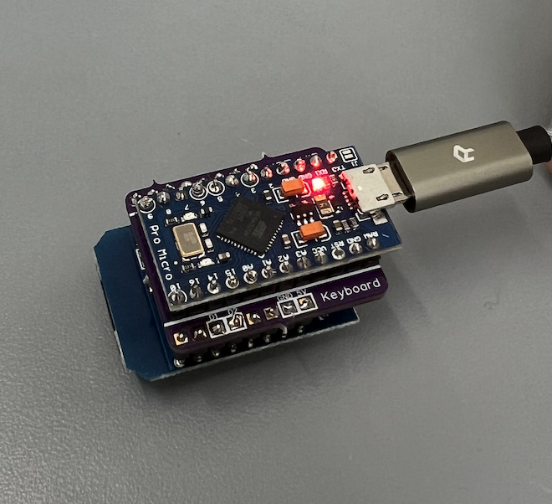
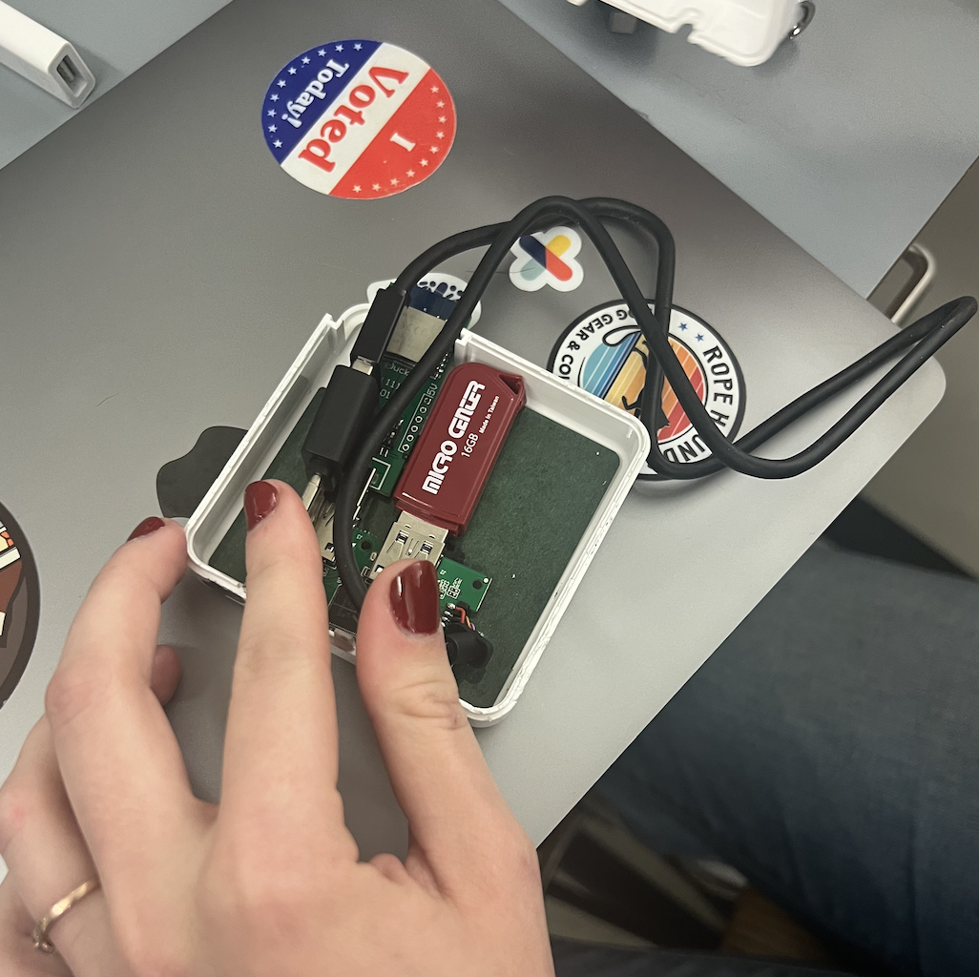
Concealed BadUSB as a method of cyberattack
Tsani Rogers and Sophia Evans
Background
Results
Conclusion
A BadUSB is a cybersecurity attack disguised as an innocent device such as a keyboard or thumb drive. BadUSB attacks rely on the targeted user plugging the device into their computer voluntarily, at which point the device injects a script to perform actions on the target computer.
This project explores new methods of concealing a BadUSB inside USB-C charging ports using a
Device Tested | Result
iPad Air 4th generation (iPadOS 16.1.1) | Code ran immediately. No pop ups or device detection.
MacBook Air M1 (macOS Big Sur 11.2.3) | Wi-Fi Duck detected as keyboard, prompting “Keyboard Setup” pop-up.
MacBook Air M1 (macOS Ventura 13.0) | Code ran immediately. No pop ups or device detection.
iPhone 8 (iOS 14.7.1) | Attack unsuccessful.
iPhone 12 Mini (iOS 16.1.2) | Attack unsuccessful.
iPhone 13 (iOS 16.0) | Attack unsuccessful.
Of the devices tested, iPhones appear to be the most secure when attempting an attack via a BadUSB.
Theories:
Increased security protocols
Difference in hardware
Image 3 Early evolution of internal layout for modified power brick.
Method and Materials
Materials:
Arduino Pro Micro (ATmega32U4)
Wi-Fi module (D1 mini ESP8266)
Custom PCB
Method:
Solder components together via the custom PCB → Wi-Fi Duck
Flash code to each component using the Arduino IDE
Load malicious script onto Duck
Open power brick and replace internal parts with Duck
Connect device to power brick via a normal USB-C charging cable
Duck automatically injects script to target device
Image 4 Improved layout incorporating storage in the form of a thumb drive, for exfiltration of files.
Image 1 Soldering the ATmega32U4 Pro Micro (blue), to the custom PCB (purple).
Image 2 The final Wi-Fi Duck, composed of three layers: D1 Mini (bottom), custom PCB (middle), and Pro Micro (top).
How bad can it be?
How to protect yourself
Adding memory to device to steal important information from targeted computers
Sending files from targeted computer to remote location over SSH
Disable keyboard and mouse so user cannot interfere
Disable any pop ups which highlights an external device has been connected
Clear ports after Wi-Fi Duck is connected
Sending text messages on behalf of the user
USB port blocker to physically prevent insertion
Special programs to monitor typing speeds
Restricting access to elevated command prompt

